Slide 1
Saliency Guided Subdivision for Single-View Mesh Reconstruction
Hai Li*, Weicai Ye*, Guofeng Zhang, Sanyuan Zhang,Hujun Bao
State Key Lab of CAD&CG, Zhejiang University
{garyli, yeweicai, zhangguofeng, syzhang, baohujun}@zju.edu.cn
Notes:
Hello, I'm Li Hai from Zhejiang University. This is our work on single-view 3D object reconstruction based on mesh deformation.

Slide 2
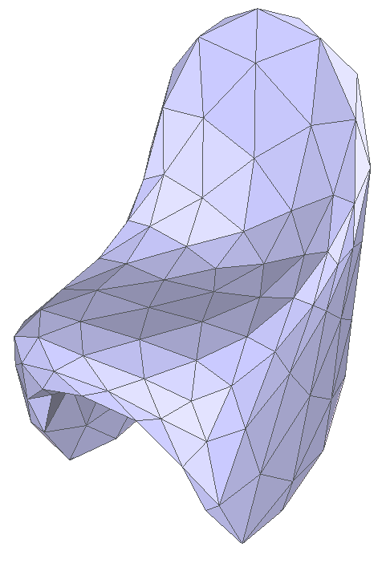
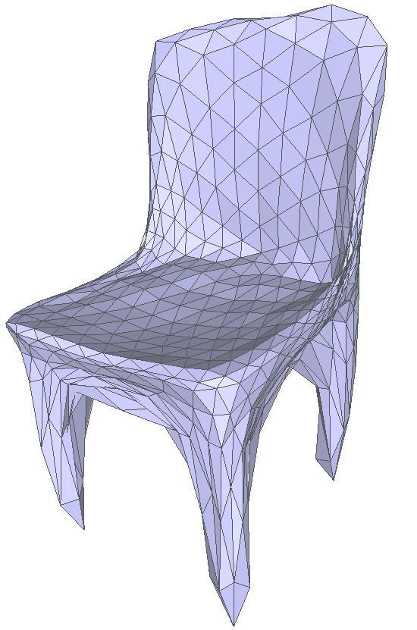
Motivation
1-to-4
subdivision
1-to-4
subdivision
Vertex and face number increase exponentially
Notes:
Most existing deformation based methods (e.g Pixel2Mesh) make coarse-to-fine predictions by repeatedly applying global subdivision (also konwn as 1-to-4 subdivision) to current mesh, which brings exponentially increasing number of vertices and faces. The huge memory consumption constrains the depth of subdivision seriously.

Slide 3
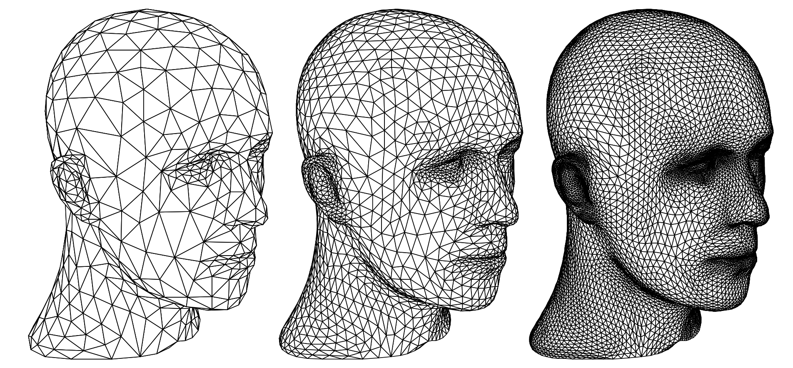
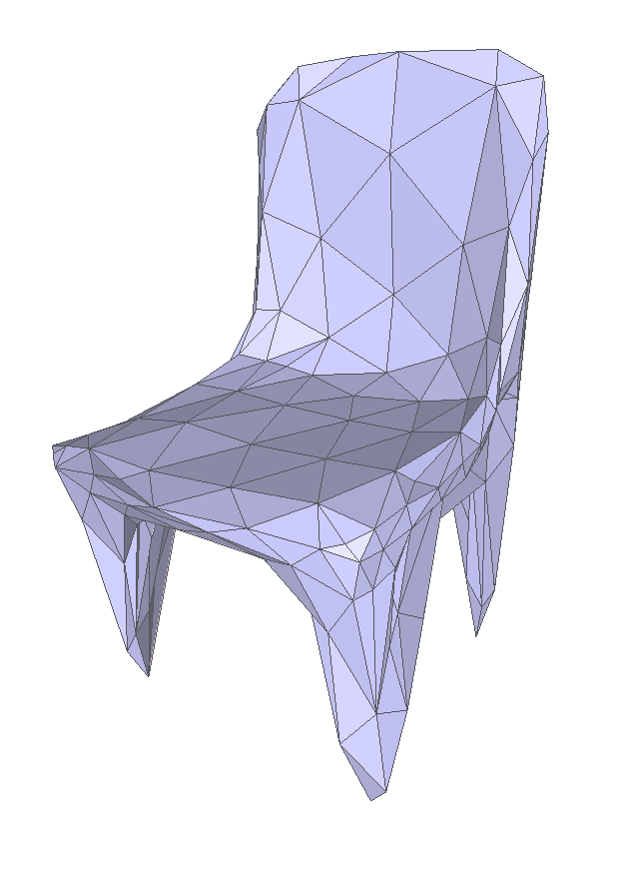
Motivation
Zorin, Denis. "Subdivision for modeling and animation." SIGGRAPH2000 course notes (2000)
dense mesh
sparse mesh
Our goal is to generate sparse mesh without losing details
Notes:
Adaptive Subdivision is the dynamic process of subdividing the initial mesh into smaller areas where required, which is a trade-off between detail generation and memory consumption. This idea is also satisfies our goal to generate sparse mesh without losing details.

Slide 4
Motivation
traditional adaptive subdivision
based on human interaction or local geometric cues
based on current state
Not suitable for progressive deformation-based reconstruction
Notes:
Traditional adaptive subdivision methods are based on human interaction or local geometric cues (e.g. curvature) and based on current mesh state, which can not directly applying on progressive deformation-based reconstruction

Slide 5
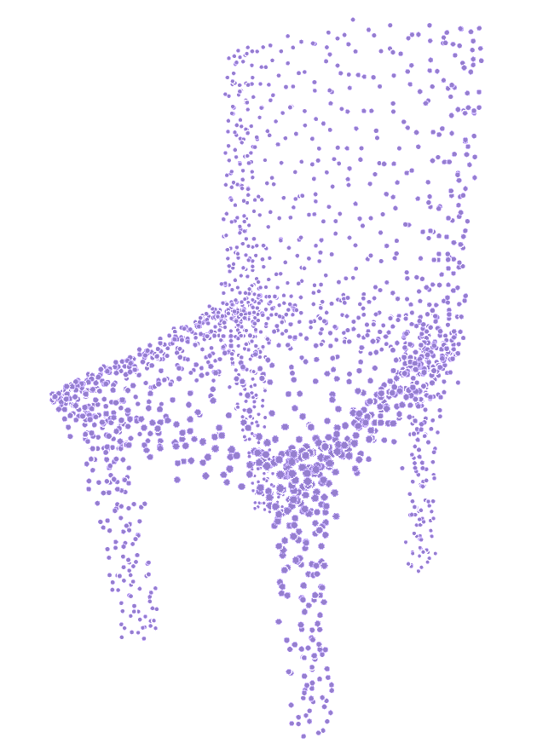
Our Method
1-to-4
subdivision
salient points
sparse in non-detailed areas
dense in detailed areas
capture global structure and local details
Notes:
Inspired by traditional adaptive subdivision, we introduce a global point-based saliency voting operation to guide the adaptive subdivision and deformation explicitly. These points are sparse in non-detailed areas (e.g. flat faces) but much denser in fine-detailed areas such as sharp edges, which capture both global structure and local details.
We first compute the nearest edge on the mesh for each point from saliency points and a voting strategy is then utilized to pick up top K voted edges.

Slide 6
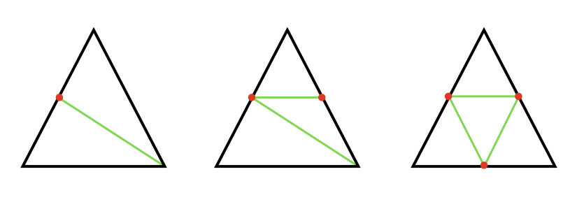
Our Method
The Green Rule
1-to-4
subdivision
adaptive
subdivision
We choose edges instead of faces to split and
adopt the Green Rule to generate new edges
Notes:
The chosen edges are split into two edges by adding a new vertex in the middle.
To keep the valence of vertex and prevent the appearance of cracks, we adopt the Green Rule Algorithm to generate new edges.

Slide 7
Framework
configurable settings
Notes:
The whole network extends Pixel2Mesh to a configurable framework and mainly consists of three sub-networks, namely image feature extraction network, saliency point deformation network and mesh deformation network.
The feature map extracted by the image feature network is associated with points and mesh vertices
via projection in other two networks.
The saliency point deformation network deforms the initial points with local point feature and image feature to the salient regions.
The output point set further guides the selection of subdivision areas through a saliency voting strategy.
The mesh deformation network deforms an initial mesh with local mesh feature and image feature to a final shape mesh in a coarse to fine manner.
Our network support configurable settings which mean the last two modules of deformation network can be iterated as many times as desired respectively

Slide 8
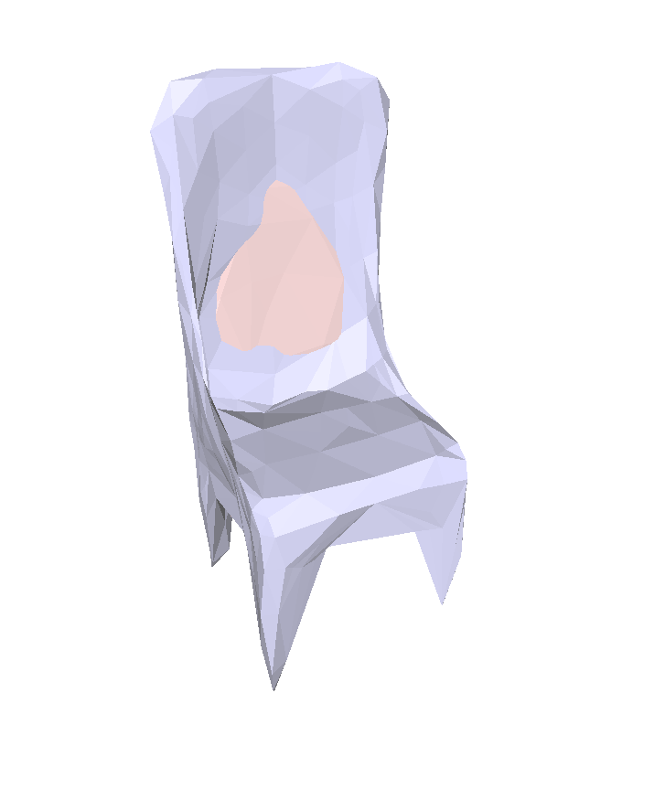
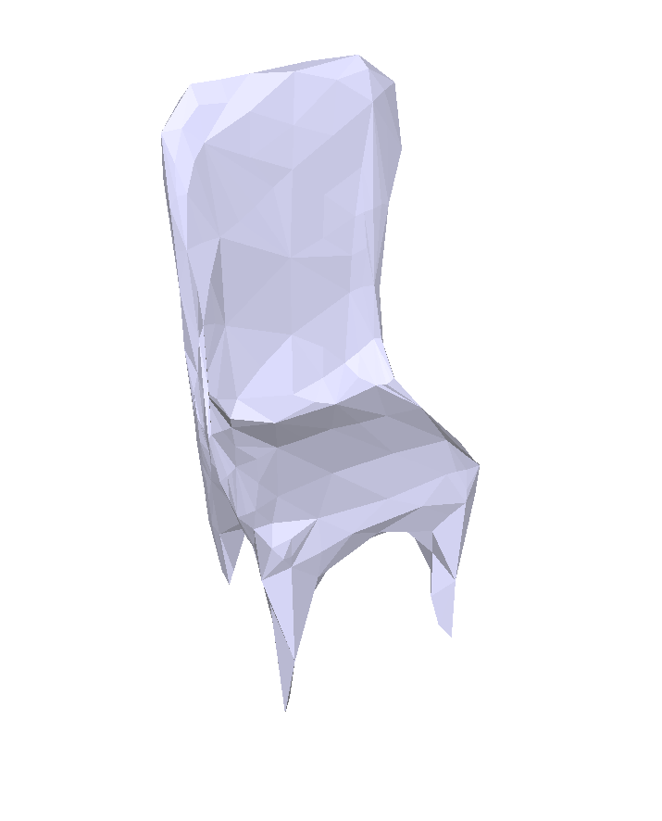
Oriented Chamfer Loss
self-intersection
Quantitative comparison
w/o oriented chamfer loss
w/ oriented chamfer loss
Notes:
In the mesh deformation based method, we can get not only the position of sampled points but also their normal
direction since they all lie on the surface. If two points have
opposite normal direction, (blue and green point) standard chamfer loss will cause the problem
like self-intersection. T
o this end, we propose an oriented chamfer loss to force the normal consistency of matching
point pairs (blue and yellow point).
The result demonstrates that the oriented chamfer loss mitigates the problem
of surface intersection effectively.

Slide 9
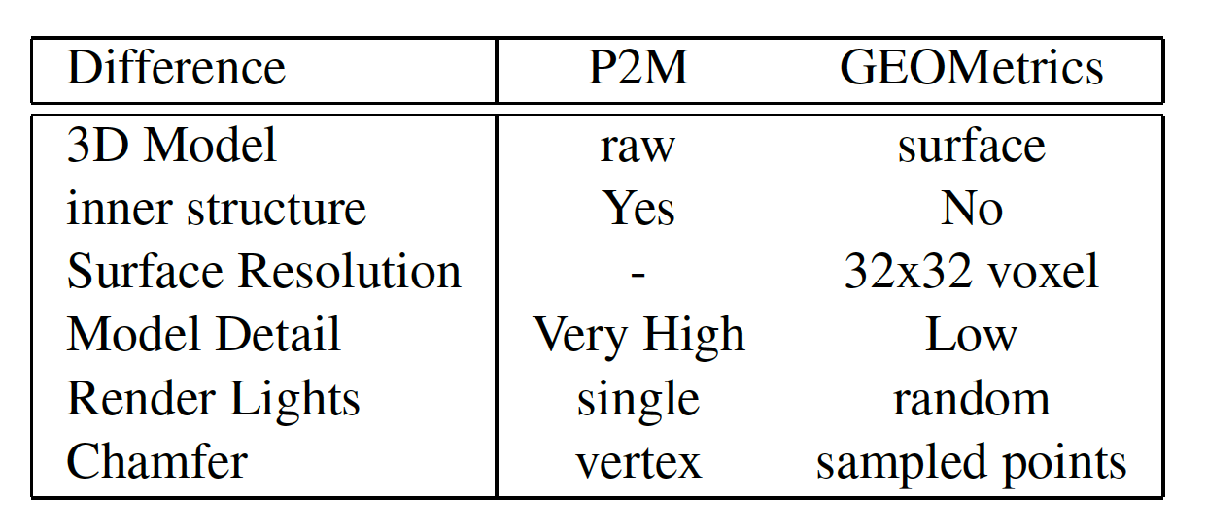
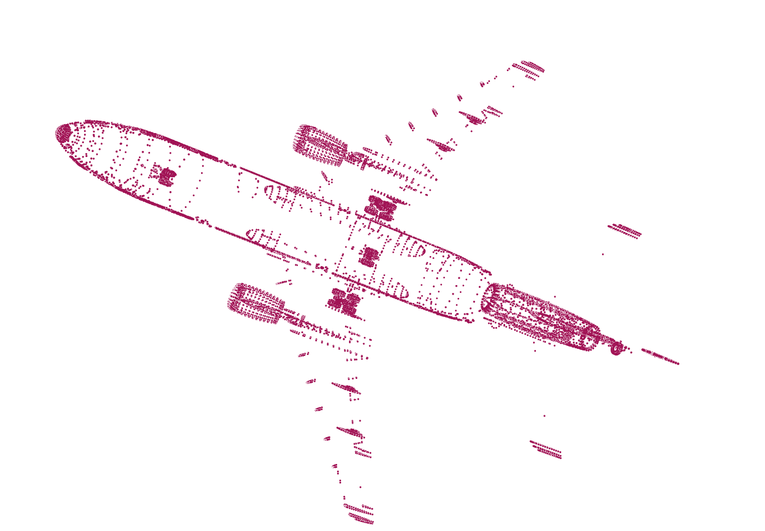
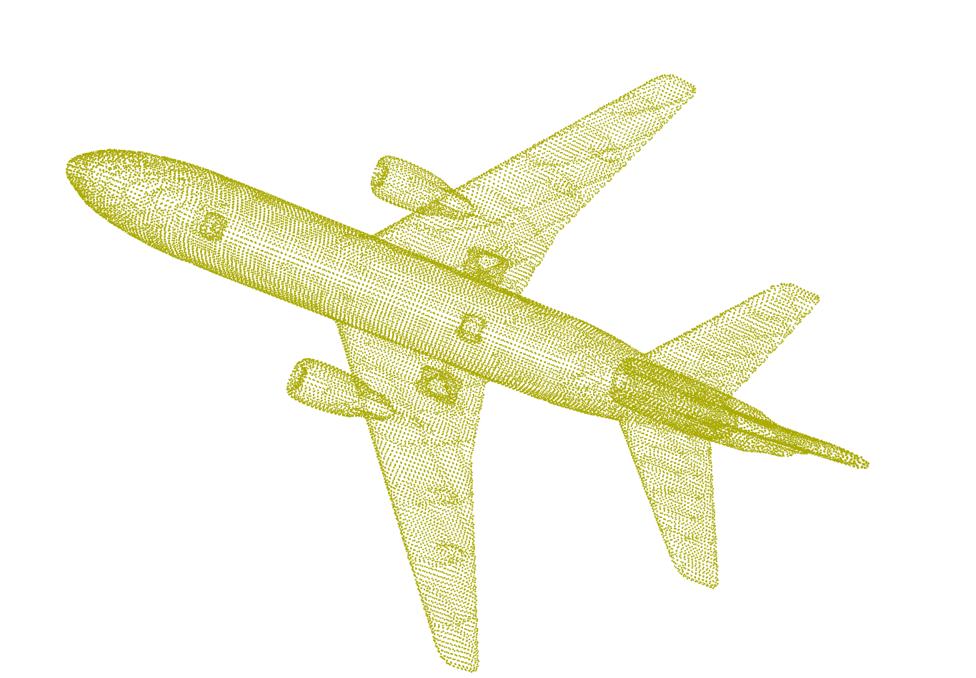
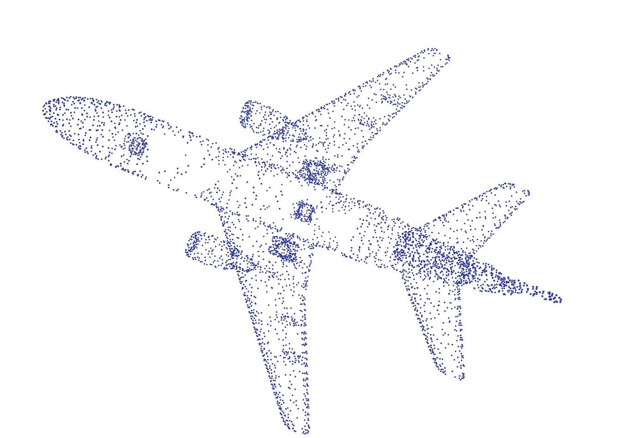
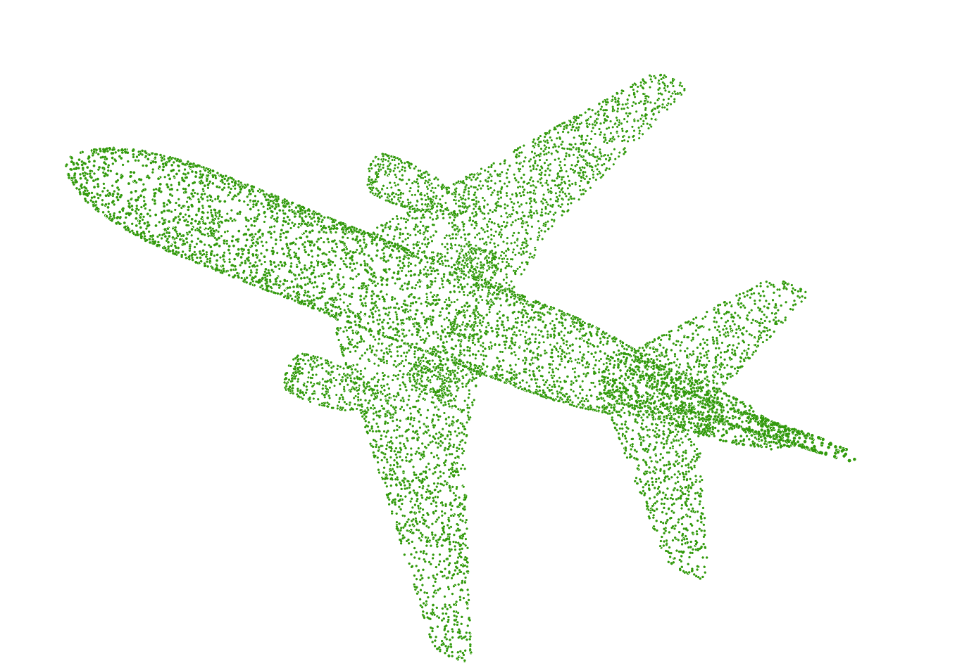
Dataset
Existing methods use inconsistent datasets and evaluation metrics
We unified the dataset and evaluation metrics which preserves high resolution (1000 x 1000 voxels) surface without inner structure
original model
mesh from ShapNet
watertight model
high resolution
surface mesh
simplified model
mesh after decimation
sampled point
uniform sampled surface points
supervision of salient points
Notes:
We mainly compare with two mesh deformation based method Pixel2Mesh and GEOMetrics. However, we found they adopted the inconsistent datasets and different evaluation strategies. To make fair comparison, we unified the dataset and evaluation metrics which preserves high resolution surface without inner structure.
We take the 4-steps to create our dataset, since the vertices of simplified model satifies the request of salient points, we use it to supervise the saliency deformation during training.

Slide 10
Experiments
The modular loss is weighted sum of
edge loss
laplacian loss
move loss
oriented chamfer loss
saliency loss
Adaptive subdivision module
Remove the edge loss
Weaken the move loss
(vertices adjacent to newly generated ones)
Structure comparison
Notes:
The modular loss function of our system is a weighted sum of listed losses, To encourage the vertices to grow to the salient areas, we
remove the edge loss in the adaptive subdivision module and weaken the move loss for vertices adjacent to newly generated vertices.
We explore the performance under different configurations, The result reveals that too few vertices
and faces fail to well capture the global structure, while too much global refinement modules hinder the representation
of local details. Since one global and one adaptive refinement modules take a good balance of both, therefore obtaining
the best performance.

Slide 11
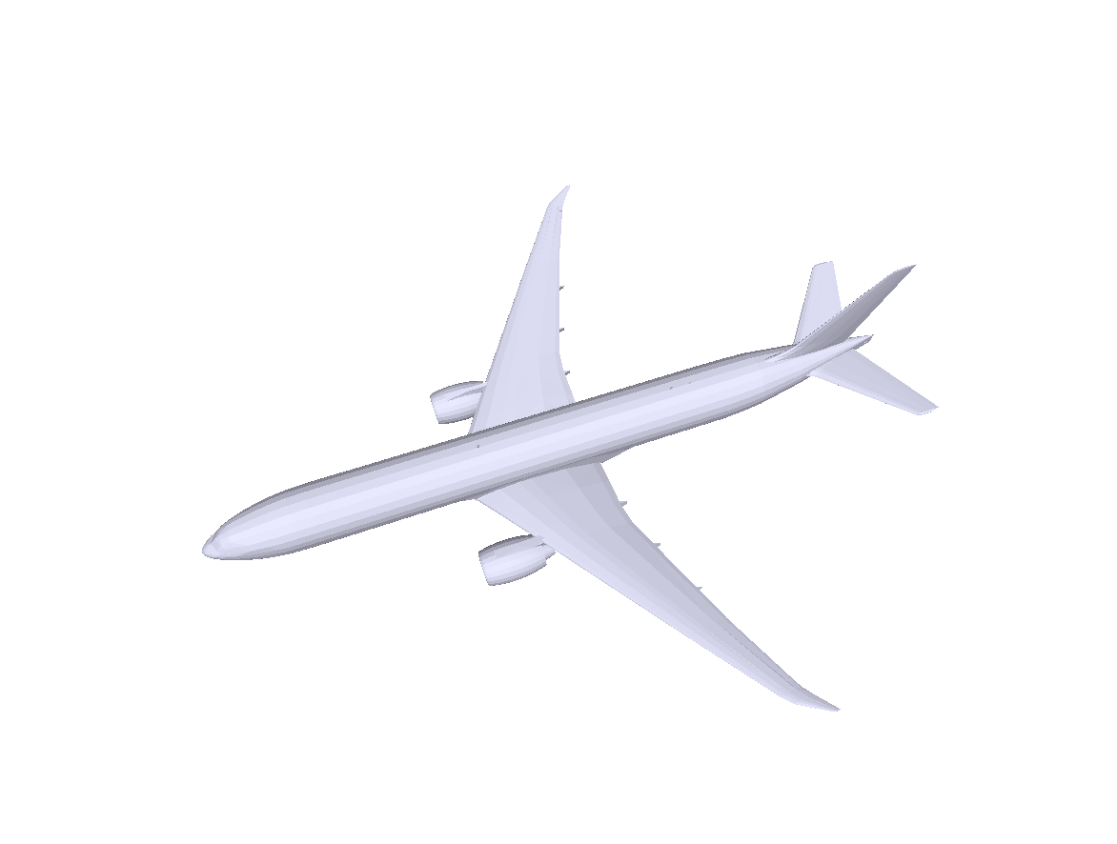
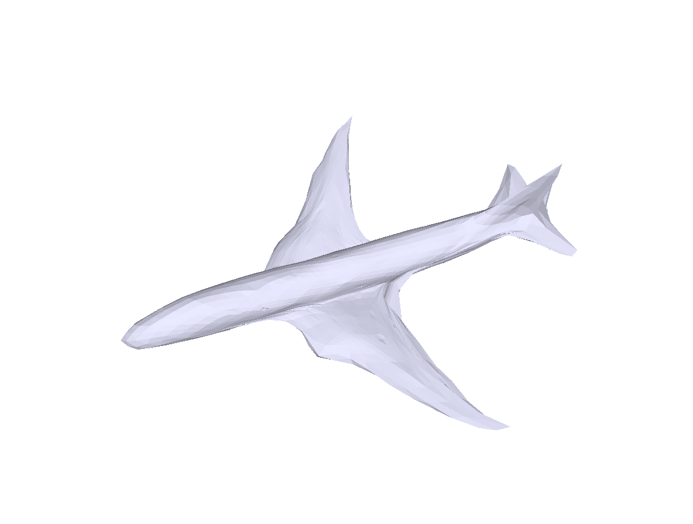
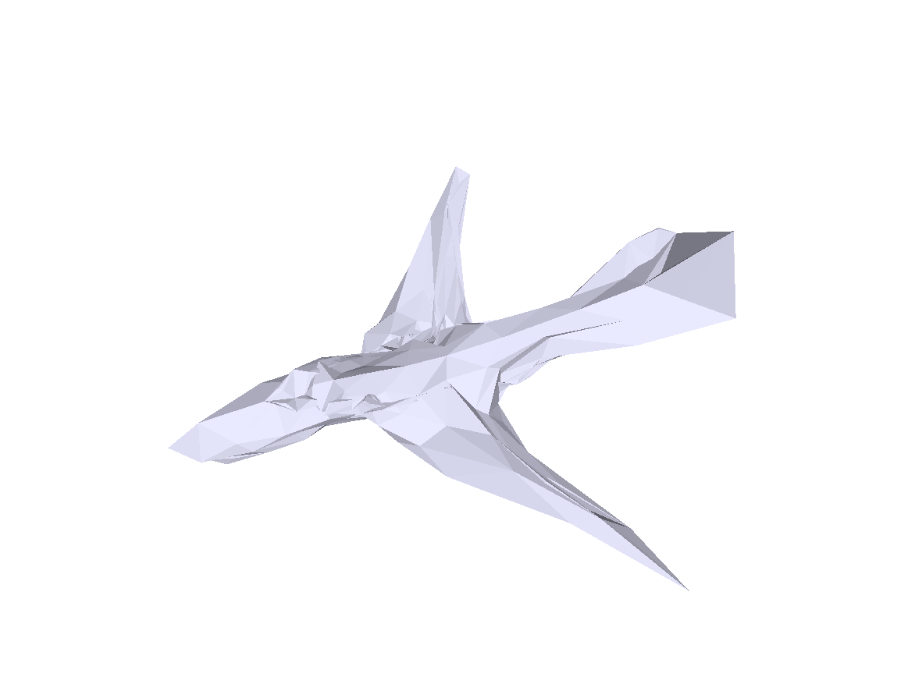
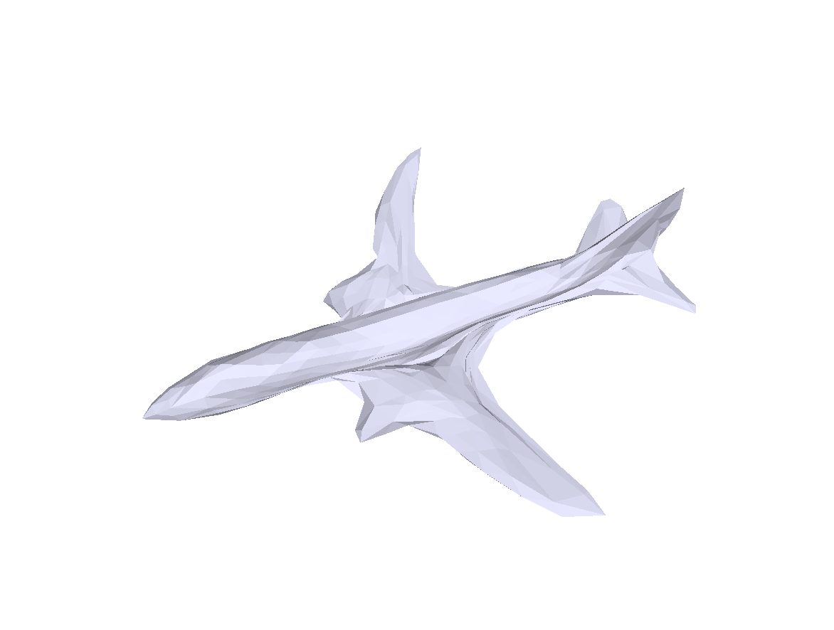
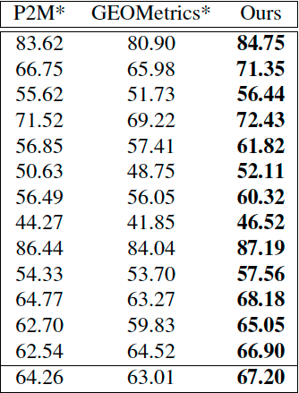
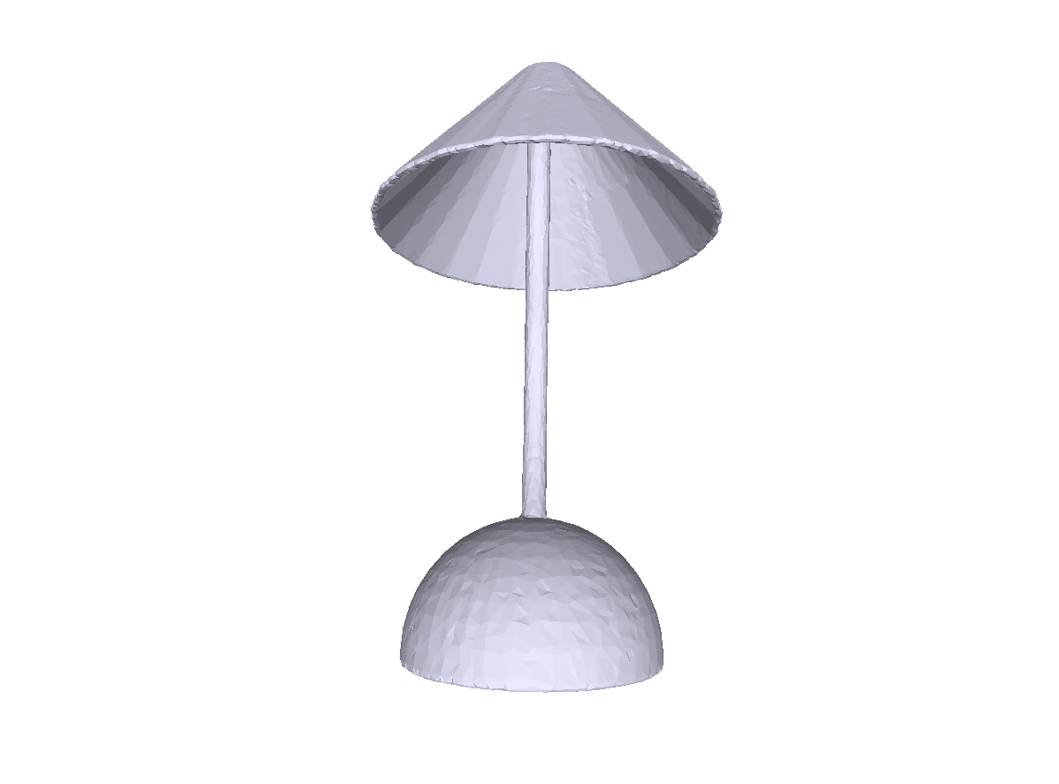
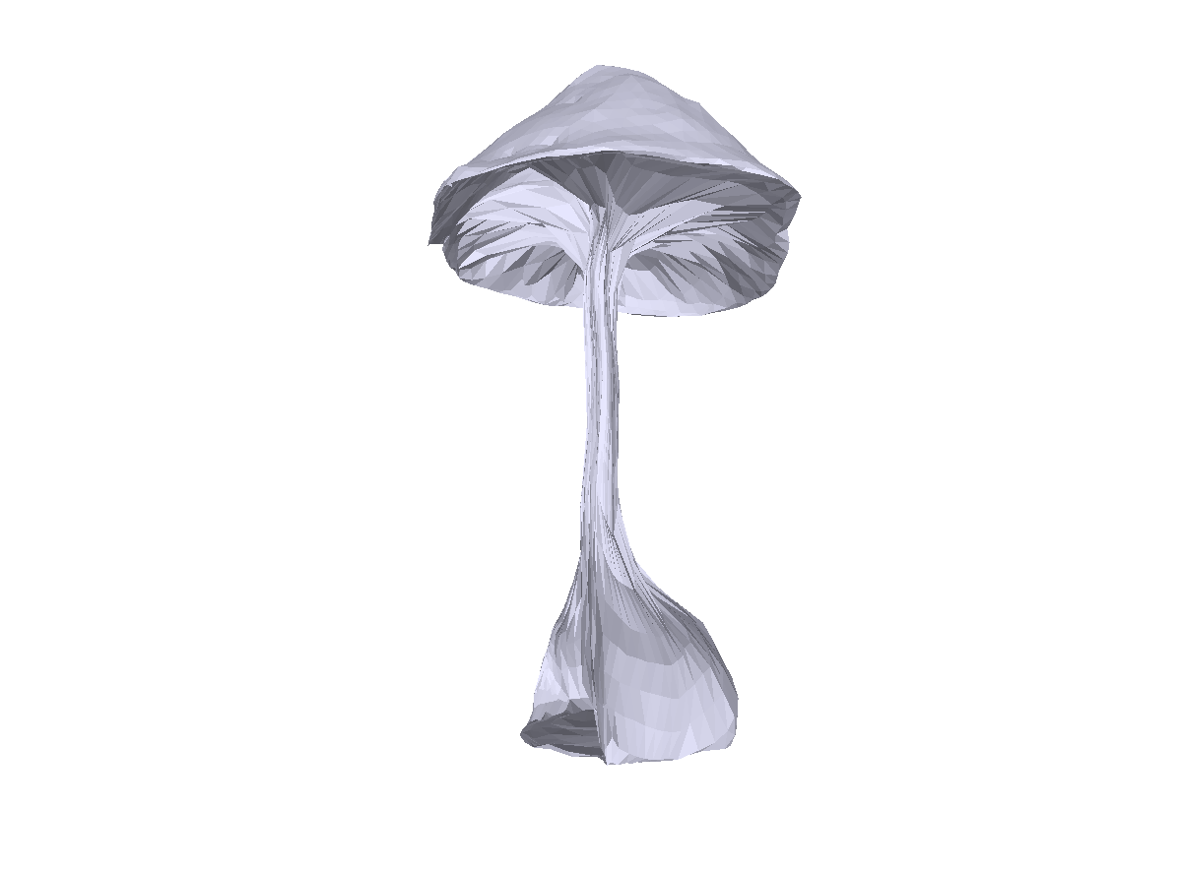
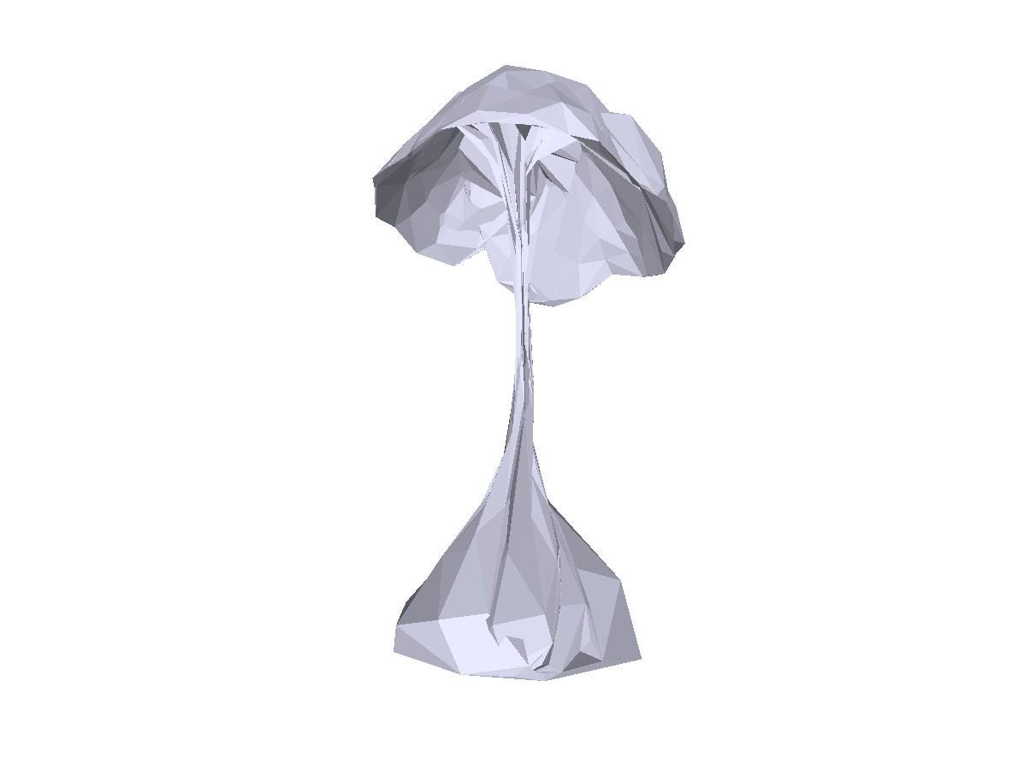
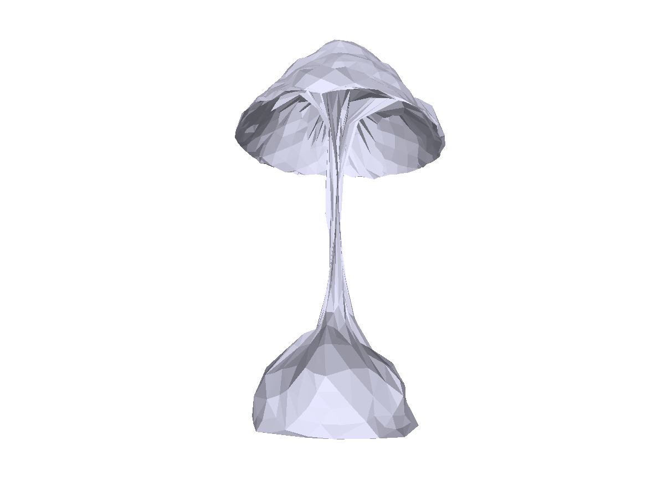
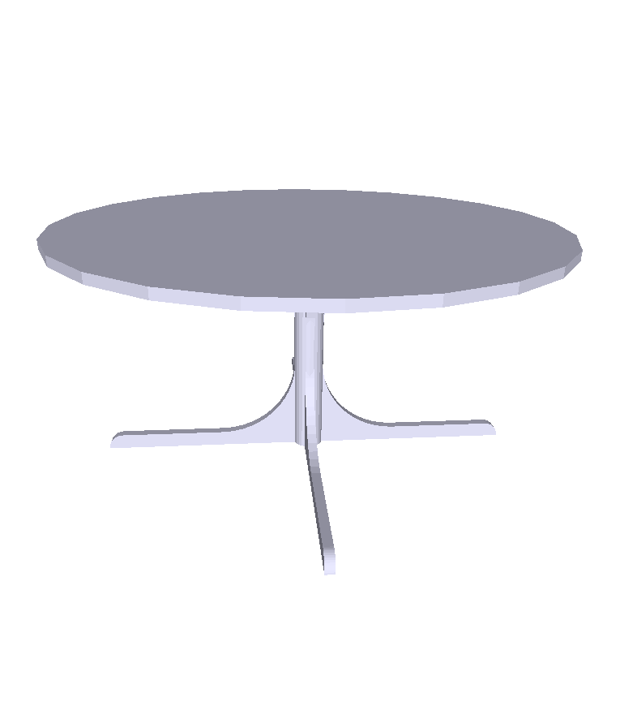
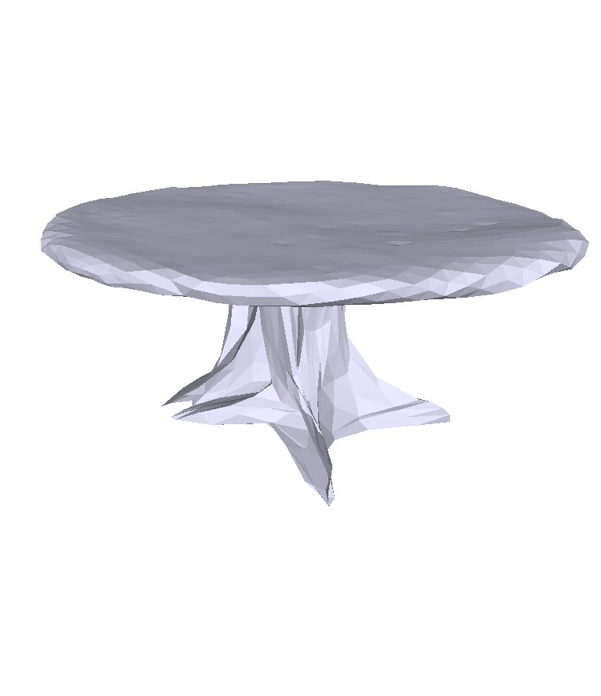
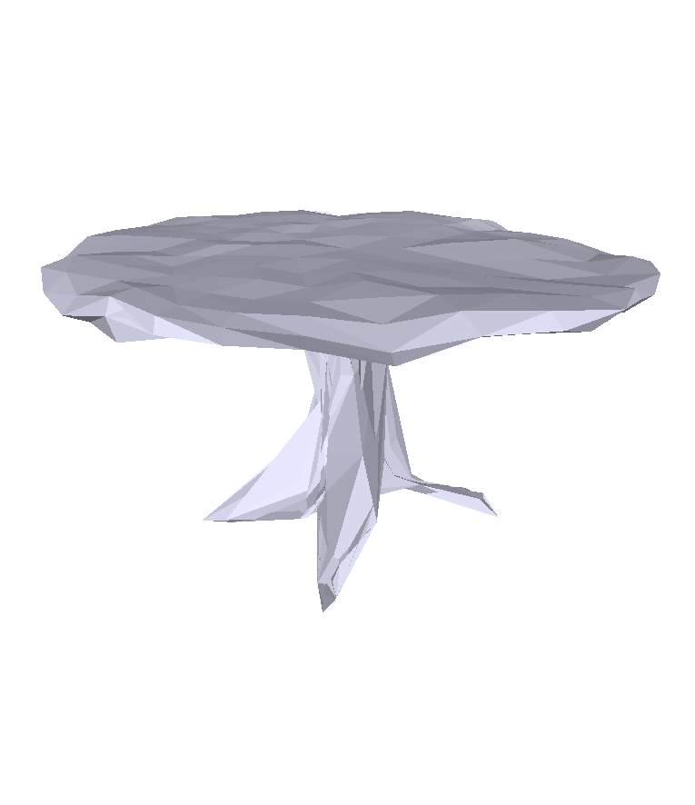
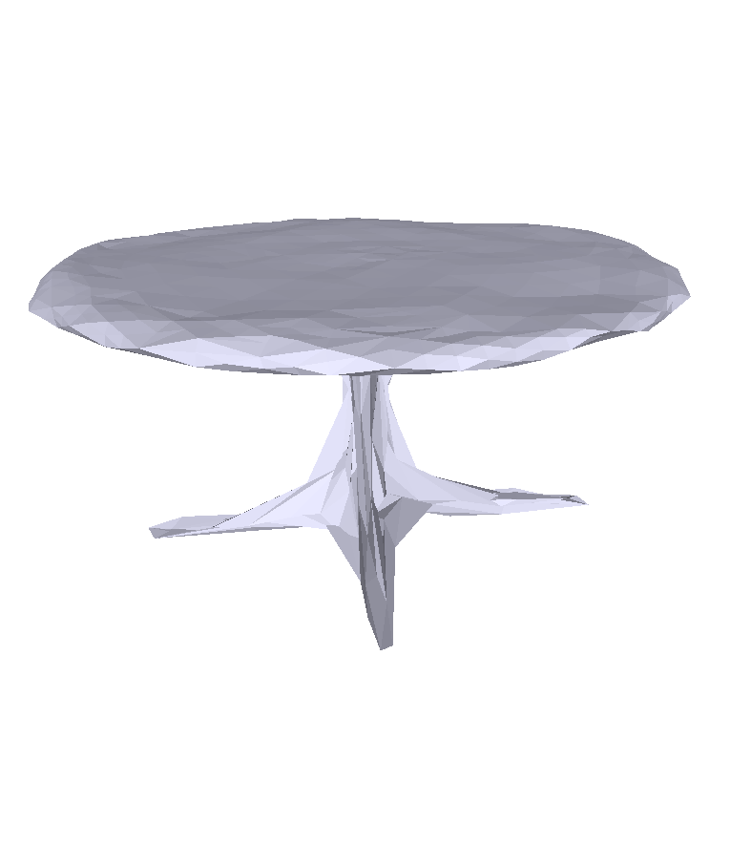
Experiments
GT
Pixel2Mesh
GEOMetrics
Ours

